Slide 1

Chatbot and Dialogue Systems

Slide 2
Contents
Introduction
Types of Dialogue Systems
Components od Dialogue Systems
Dialogue Management
Natural Language Understanding (NLU)
Natural Language Generation (NLG)
Training and Fine-Tuning Chatbots

Slide 3
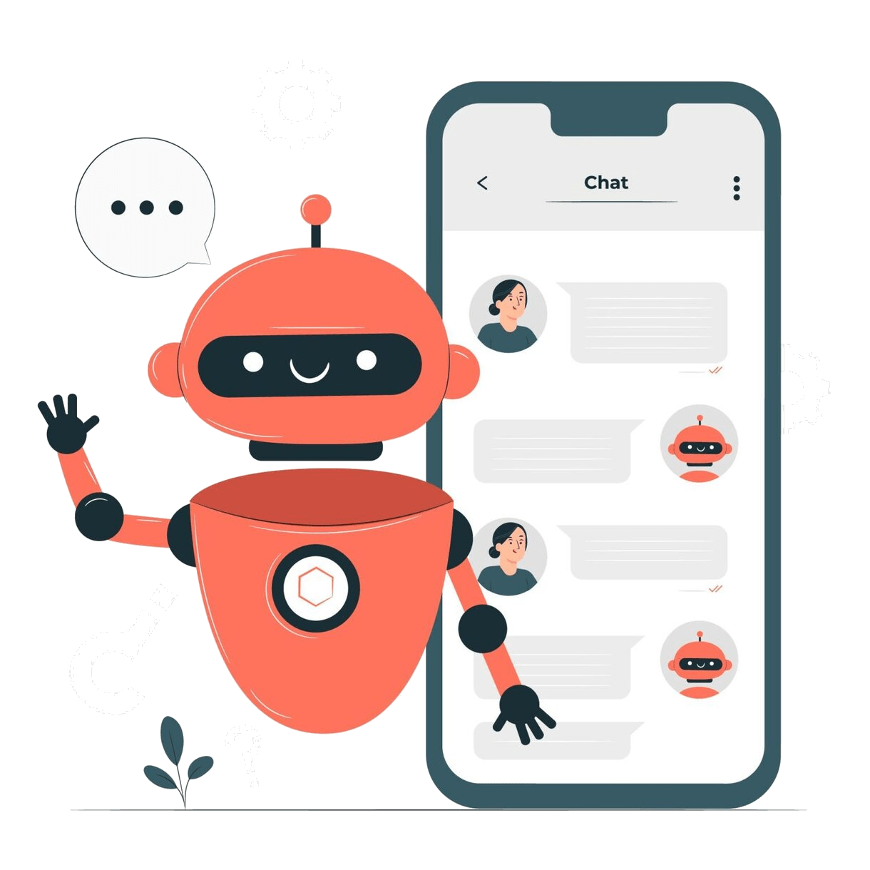
Introduction
Chatbots
  Chatbots are computer programs specifically designed to simulate human conversation.
  They use Natural Language Processing (NLP) techniques to understand and generate human language, allowing them to interact with users through text or speech in a conversational manner.

Slide 4
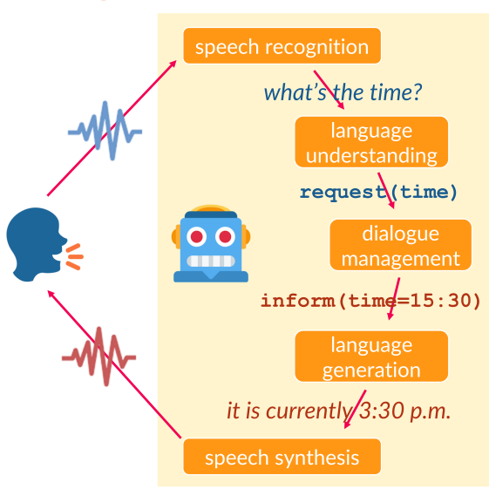
Introduction
Dialogue Systems
  on the other hand, encompass a broader range of systems that handle natural language interactions.
  While chatbots are a subset of dialogue systems, the latter can include more complex systems that engage in multifaceted conversations, such as virtual assistants, customer support bots, and even intelligent tutoring systems.

Slide 5
Introduction
Importance of Chatbots
  Customer Service
    Chatbots provide immediate assistance and support to customers, addressing their queries and concerns 24/7. This enhances customer satisfaction and reduces the load on human customer support agents.
  Information Retrieval
    Chatbots serve as efficient tools for retrieving information from large databases or websites. They can answer questions, provide recommendations, and guide users to relevant resources.
  E-commerce
    In the realm of online shopping, chatbots can help users navigate products, answer questions about items, process orders, and even offer personalized shopping suggestions.
  Appointment Scheduling
    Chatbots can streamline appointment scheduling by interacting with users to find suitable time slots, reducing the back-and-forth communication.
  Language Learning
    Intelligent chatbots can assist users in learning new languages by engaging in conversations, providing vocabulary explanations, and offering language practice.
  Healthcare
    Chatbots can provide initial medical advice, answer health-related questions, and help users understand symptoms before seeking professional medical help.
  Virtual Assistants
    Advanced chatbots, often referred to as virtual assistants, can perform tasks like setting reminders, sending notifications, controlling smart devices, and managing personal schedules.
  Entertainment and Engagement
    Chatbots can offer entertainment by engaging users in interactive games, quizzes, storytelling, and even simulated role-playing scenarios.

Slide 6
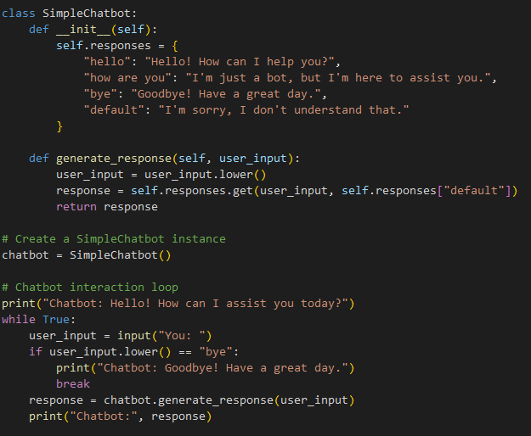
Introduction
Example
We define a SimpleChatbot class with predefined responses for certain user inputs.
The generate_response method looks up the user's input in the responses dictionary and returns the corresponding response.
The chatbot interaction loop continues until the user enters "bye".
The chatbot responds based on the user's input using the predefined responses.

Slide 7
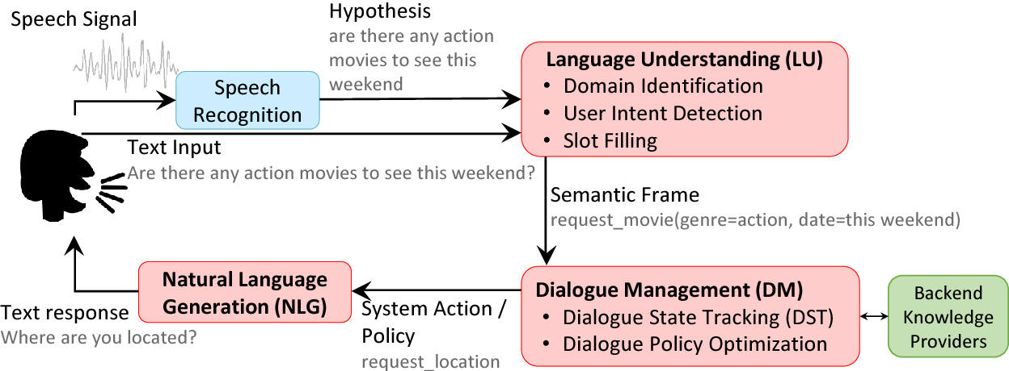
Types of Dialogue Systems
Task-Oriented Dialogue Systems
  Task-oriented dialogue systems, also known as goal-driven or transactional systems, are designed to assist users in achieving specific objectives or tasks.
  These systems focus on providing efficient solutions by understanding user intents and guiding them through a structured conversation to complete tasks.
  Examples include virtual assistants for booking flights, making reservations, or checking the weather.

Slide 8
Types of Dialogue Systems
Open-Domain Dialogue Systems
  Open-domain dialogue systems, also called chatbots, are designed to engage in more general and open-ended conversations with users.
  Unlike task-oriented systems, open-domain systems do not have a predefined goal or task to fulfill.
  Instead, they aim to generate natural and meaningful conversations on a wide range of topics, often leveraging large language models to provide contextually relevant responses.

Slide 9
Types of Dialogue Systems
Hybrid Dialogue Systems
  Hybrid dialogue systems combine elements of both task-oriented and open-domain approaches.
  These systems are versatile and can switch between specific tasks and general conversations based on user interactions.
  They provide the flexibility to address user needs for both structured task completion and casual conversations.
  Examples include virtual assistants that can book appointments and also engage in chit-chat.

Slide 10
Components od Dialogue Systems
Natural Language Understanding (NLU)
  Natural Language Understanding (NLU) is a critical component of dialogue systems that focuses on interpreting and extracting meaning from user inputs, which can be in the form of text or speech.
  NLU involves various tasks such as intent recognition, entity extraction, and sentiment analysis. It aims to comprehend user intentions, identify relevant information, and transform user inputs into a structured format that the system can process.
  NLU helps dialogue systems understand user queries, prompts, or statements, enabling accurate and contextually relevant responses.

Slide 11
Components od Dialogue Systems
Dialogue Management
  Dialogue Management is responsible for orchestrating the conversation flow and decision-making within a dialogue system.
  It involves tracking the dialogue state, managing the system's actions and responses, and determining the appropriate next step in the conversation.
  Dialogue management systems use rules, state-based approaches, or more advanced techniques like reinforcement learning to navigate through the conversation, ensuring coherent interactions and achieving user goals.
  Effective dialogue management results in meaningful and goal-oriented conversations.

Slide 12
Components od Dialogue Systems
Natural Language Generation (NLG)
  Natural Language Generation (NLG) is the component responsible for generating human-like responses in natural language based on the system's understanding of the user's input and the ongoing conversation context.
  NLG techniques involve selecting appropriate words, phrases, and structures to craft coherent and contextually relevant responses.
  NLG can also take into account factors such as the user's preferences, the formality of the conversation, and the system's personality.
  The goal of NLG is to create responses that feel human-like and meet user expectations.

Slide 13
Dialogue Management
Role of Dialogue Management in Chatbots
  Rule-Based Approach:
    In a rule-based approach, dialogue management relies on predefined sets of rules and decision trees.
    The chatbot follows a scripted path, determining responses based on the detected user intent and predefined rules.
    While this approach is straightforward and controllable, it might struggle with handling complex interactions or handling novel user inputs that don't fit within the predefined rules.
  Machine Learning-Based
    Machine learning-based dialogue management employs techniques such as supervised learning, where models are trained on labeled dialogue data to predict the best response given a certain context.
    Reinforcement learning can also be used, where the chatbot learns from interactions by receiving rewards based on the quality of the conversation.
    This approach is more adaptive and can handle a wider range of user inputs, but it requires substantial training data and careful tuning to achieve optimal performance.
  Reinforcement Learning-Based
    Reinforcement learning-based dialogue management involves the use of reinforcement learning algorithms to optimize the chatbot's dialogue strategy.
    The chatbot interacts with users, receives feedback on the quality of its responses, and adjusts its behavior to maximize a reward signal.
    This approach allows the chatbot to learn from trial and error, improving its conversation capabilities over time.

Slide 14
Natural Language Understanding
Key Tasks in NLU
  Intent Recognition
    NLU identifies the user's intention or purpose behind their input. It determines what action the user wants the system to perform.
    For instance, in a weather chatbot, if a user asks "What's the forecast for tomorrow?", the intent is to get weather information.
  Entity Extraction
    This involves identifying specific pieces of information within the user input, known as entities. Entities provide context for the intent.
    For example, in the previous weather query, "tomorrow" is the entity indicating the specific day for the forecast.

Slide 15
Natural Language Understanding
Techniques in NLU
  Rule-Based Parsing
    Rule-based approaches involve creating sets of rules or patterns to identify intents and entities. These rules are often defined by human experts and can be effective for specific use cases. However, they might struggle with handling diverse and complex user inputs.
  Machine Learning Models
    Machine learning techniques, such as neural networks, can be trained on labeled data to learn patterns in user inputs. Neural networks, especially Recurrent Neural Networks (RNNs) and Transformer models, are effective in understanding the context and relationships between words, improving accuracy across a variety of inputs.
  Hybrid Approaches
    Many systems combine rule-based parsing with machine learning techniques. Rules can help handle well-defined intents and entities, while machine learning models enhance the system's ability to understand more nuanced or varied inputs.

Slide 16
Natural Language Generation
Approaches in NLG
  Template-Based NLG
    In this approach, predefined response templates are used to construct responses.
    These templates can be filled with relevant information obtained from the system's understanding of user inputs and the dialogue context.
    While template-based NLG is simple and controlled, it might produce generic responses that lack variety and naturalness.
  Machine Learning-Based NLG
    This approach involves training machine learning models, such as sequence-to-sequence models, on large amounts of dialogue data.
    These models learn to generate responses by predicting the next words in a sentence based on the input and context.
    Machine learning-based NLG can produce more diverse and contextually appropriate responses compared to template-based approaches.

Slide 17
Natural Language Generation
Neural Language Models in NLG
  Neural Language Models, such as Transformer-based models, have revolutionized NLG by enabling the creation of highly fluent and coherent responses.
  These models are pre-trained on massive text corpora and possess a deep understanding of language patterns, semantics, and context.
  When fine-tuned for specific dialogue tasks, they can generate responses that sound remarkably human-like.

Slide 18
Natural Language Generation
Advantages of Neural Language Models
  Contextual Awareness
    Neural models can consider the entire conversation context, leading to responses that are contextually appropriate and coherent.
  Variety and Diversity
    These models can generate a wide range of responses, avoiding repetitiveness and enhancing the naturalness of the conversation.
  Creative Language Use
    Neural models can generate creative and nuanced language, making conversations more engaging and less formulaic.
  Adaptability
    Neural models can be fine-tuned for specific domains or use cases, allowing for tailored responses that suit the dialogue context.

Slide 19
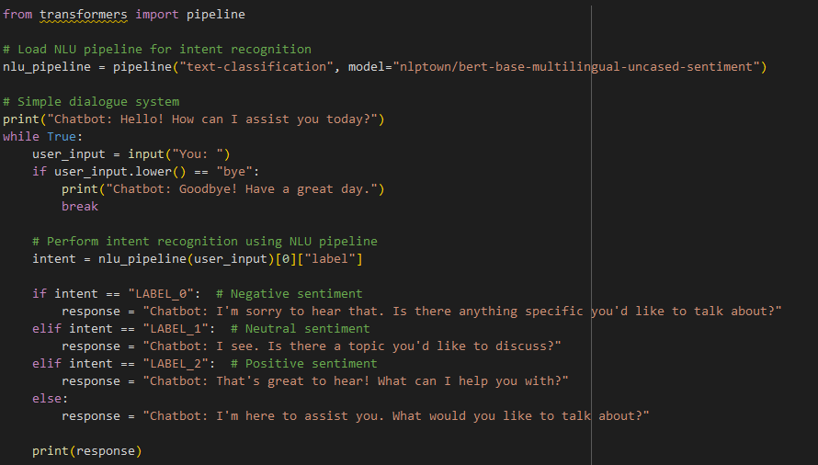
Natural Language Generation
A simple dialogue system using natural language understanding (NLU) with the Hugging Face Transformers library
We use the Hugging Face Transformers library to load a pre-trained sentiment analysis model for intent recognition.
The dialogue system engages in a conversation with the user using predefined responses based on sentiment analysis.
The sentiment analysis model classifies the user's input into one of three sentiment classes: negative, neutral, or positive.
The dialogue system generates appropriate responses based on the detected sentiment.

Slide 20
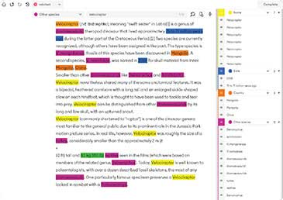
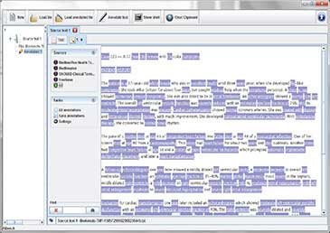
Training and Fine-Tuning Chatbots
Collecting and Annotating Dialogue Data
  Collecting a diverse and representative dataset of dialogues is the first step.
  This dataset includes pairs of user inputs and system responses.
  The data should cover various intents, user behaviors, and conversation scenarios. Annotating the data involves labeling user intents, entities, and dialogue states.
  High-quality annotated data is crucial for effective training.

Slide 21
Training and Fine-Tuning Chatbots
Training NLU, Dialogue Management, and NLG
  NLU Training
    Using the annotated data, NLU models are trained to accurately recognize user intents and extract relevant entities from user inputs.
    Machine learning models like neural networks are often employed for this task.
  Dialogue Management Training
    Depending on the approach (rule-based, machine learning-based, or reinforcement learning-based), dialogue management models are trained to navigate conversations, decide system actions, and respond to user inputs effectively.
  NLG Training
    Machine learning models, such as sequence-to-sequence models, are trained on dialogue data to generate contextually appropriate and fluent responses.
    These models learn to map input-context pairs to output responses.

Slide 22
Training and Fine-Tuning Chatbots
Fine-Tuning with User Interactions
  After initial training, the chatbot is deployed and interacts with real users.
  This is where the real learning takes place.
  User interactions provide feedback that helps the chatbot improve its responses and behavior over time.
  Fine-tuning involves using the feedback to adjust the model's parameters, enhancing its accuracy, relevance, and user satisfaction.

Slide 23
Q & A

